Slide 1
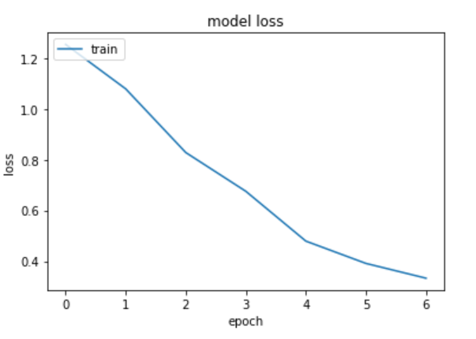
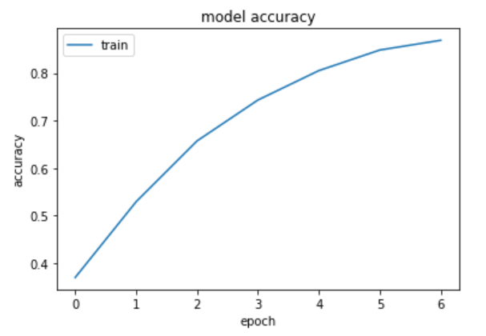
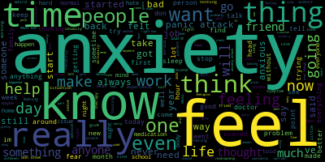
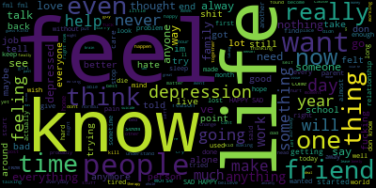
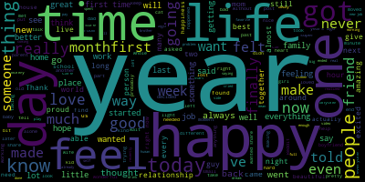
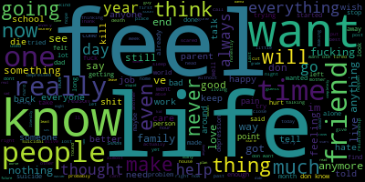
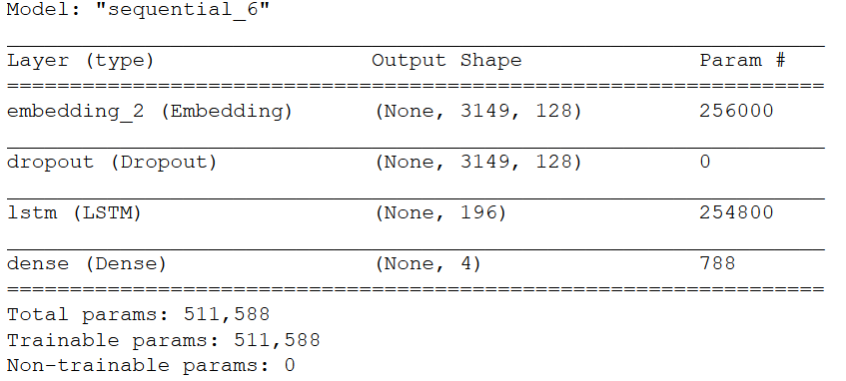

Mental Wellness Sentiment Analysis
Jiaan Nie, 200327281
SUMMARY
RESULTS
The purpose of the project is try to determine the current mental wellbeing of a person through input of their text using technique call RNN (Recurrent Neural Network). Initial plan is to create a small prototype that will work on 2 or 3 categories such as depression, anxiety and suicidal thoughts using labeled data that scraped off from websites and clean up the data using panda, then implement a basic RNN model using Tensorflow and test out the result.
REQUIREMENT
Hardware Requirements:
i7 CPU
GTX 1080 CPU
Software Requirement :
Anaconda
Tensorflow
Panda
PRAW
WordCloud
METHODS
First scrape labled data from reddit , use python to lablel and organizes the data and parses into to panda.
Split the data set into:
2/3 tranning
1/3 validation
Finally feed training data into the LSTM model and use the validation data set to validate.
IMPROVEMENTS
Tuning Hyper Parameters to improve accuracy.
Data Sanitization such as fix spelling, remove special characters , emoji etc.
More labeled data and better quality data
Testing on different activation functions
CONCLUSION
Overall the accuracy of the model is not ideal, to improve on the model it will requires better and more labeled data. Sanitizes the data before feeding into the model reduce the noise. The model it self seem having trouble classify between depression and suicide posts due the similarity of contents.

